Slide 1



GOVERNMENT OF KARNATAKA
DEPARTMENT OF COLLEGIATE TECHNICAL EDUCATION
GOVERNMENT ENGINEERING COLLEGE TALAKAL,KOPPAL-583238
DEPARTMENT OF COMPUTER SCIENCE & ENGINEERING
PROJECT ON
“CONSTRUCTION DYNAMIC PROJECT”
Under the guidance of:
Prof. VEERESH
Presented by:
RAMYASHREE V 2LG21CS033
SAVITHRA LINGANAGOUDRU 2LG21CS037
VIJAY KUMAR T 2LG21CS050
IMAMSAB BEDAVATTI 2LG21CS056

Slide 2
CONTENTS
Abstract
Introduction
Methodology
Requirements Specification
Advantages & Disadvantages
Applications
Results
Future Scope
Conclusion

Slide 3
ABSTRACT
Dynamic web application developed for a construction company to showcase its projects, offered services, and customer testimonials in an interactive manner.
Projects are presented with detailed descriptions, images, and categories to help potential clients explore relevant work.
Services are dynamically listed to highlight the company’s capabilities, while a testimonials section displays client feedback to build trust and credibility.

Slide 4
INTRODUCTION
Construction project that is characterized by frequent changes, uncertainties, and evolving requirements throughout its lifecycle.
Project aims to develop a dynamic web application for a construction company allows for the real-time display content such as projects, services, and testimonials.
It is a system that dynamically updates site progress, coordinates teams effectively, and integrates analytics for better forecasting.

Slide 5
EXISTING & PROPOSED SYSTEM
Existing system includes sever side rendering of front end to manage and showcase their services, projects and client testimonials.
The proposed system is a scalable, and fully dynamic construction website aimed at improving content management.
The admin dashboard enables full CRUD functionality for each module, without modifying the code.

Slide 6
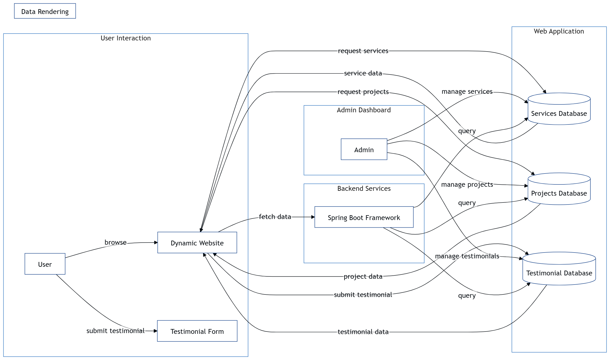
METHODOLOGY
Fig 1:Methodology

Slide 7
REQUIREMENT SPECIFICATIONS
SOFTWARE REQUIREMENTS
Operating System : Windows 10 or above
Programming Language : Java
Software : Visual Studio
Database : MYSQL
Web Framework : Spring boot

Slide 8
HARDWARE REQUIREMENTS
Processor : Intel Corei5
Input devices : Keyboard, Mouse
Output devices : Monitor (1366x768 Resolution)
RAM : 16.00GB

Slide 9
ADVANTAGES
Dynamic Content Management
Enhanced Functionality
Security & Monitoring
Embedded Server Support

Slide 10
DISADVANTAGES
High Memory Consumption
Development Costs
Security Risks
Maintenance and Updates

Slide 11
APPLICATIONS
Showcase Projects
Display Services Offered
Client Testimonials
User Engagement

Slide 12
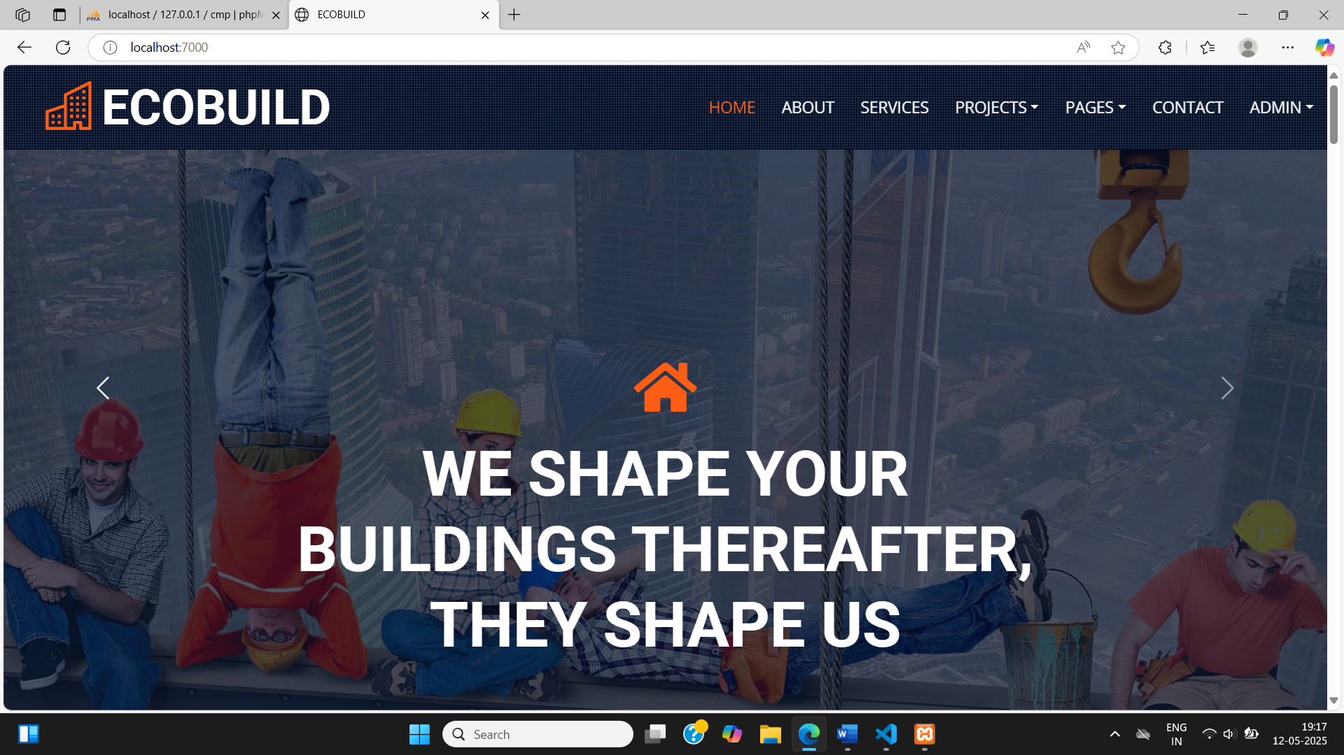
RESULTS
Fig 2:Home Page

Slide 13
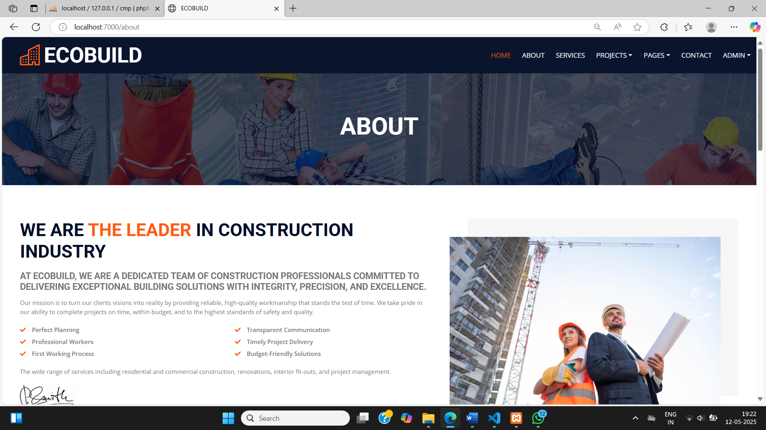
Fig 3:About Us

Slide 14
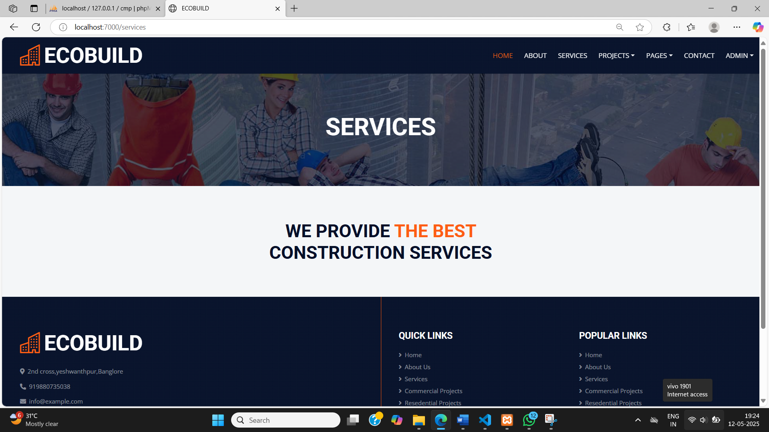
Fig 4:Services

Slide 15
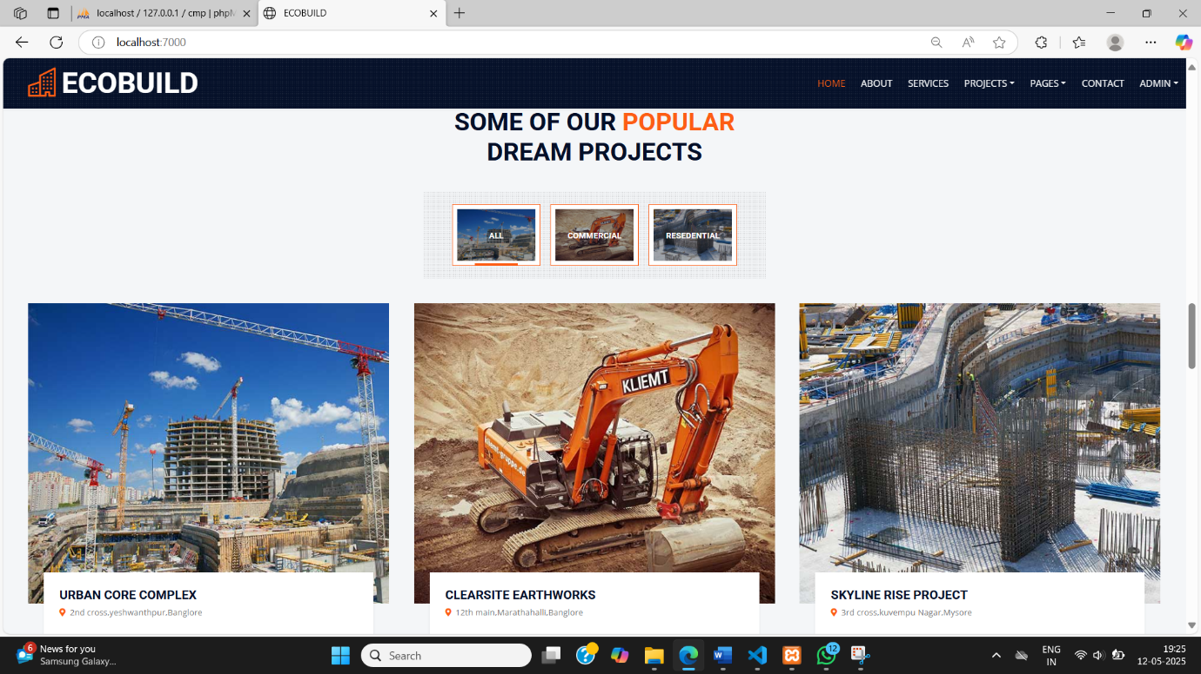
Fig 5:Projects

Slide 16
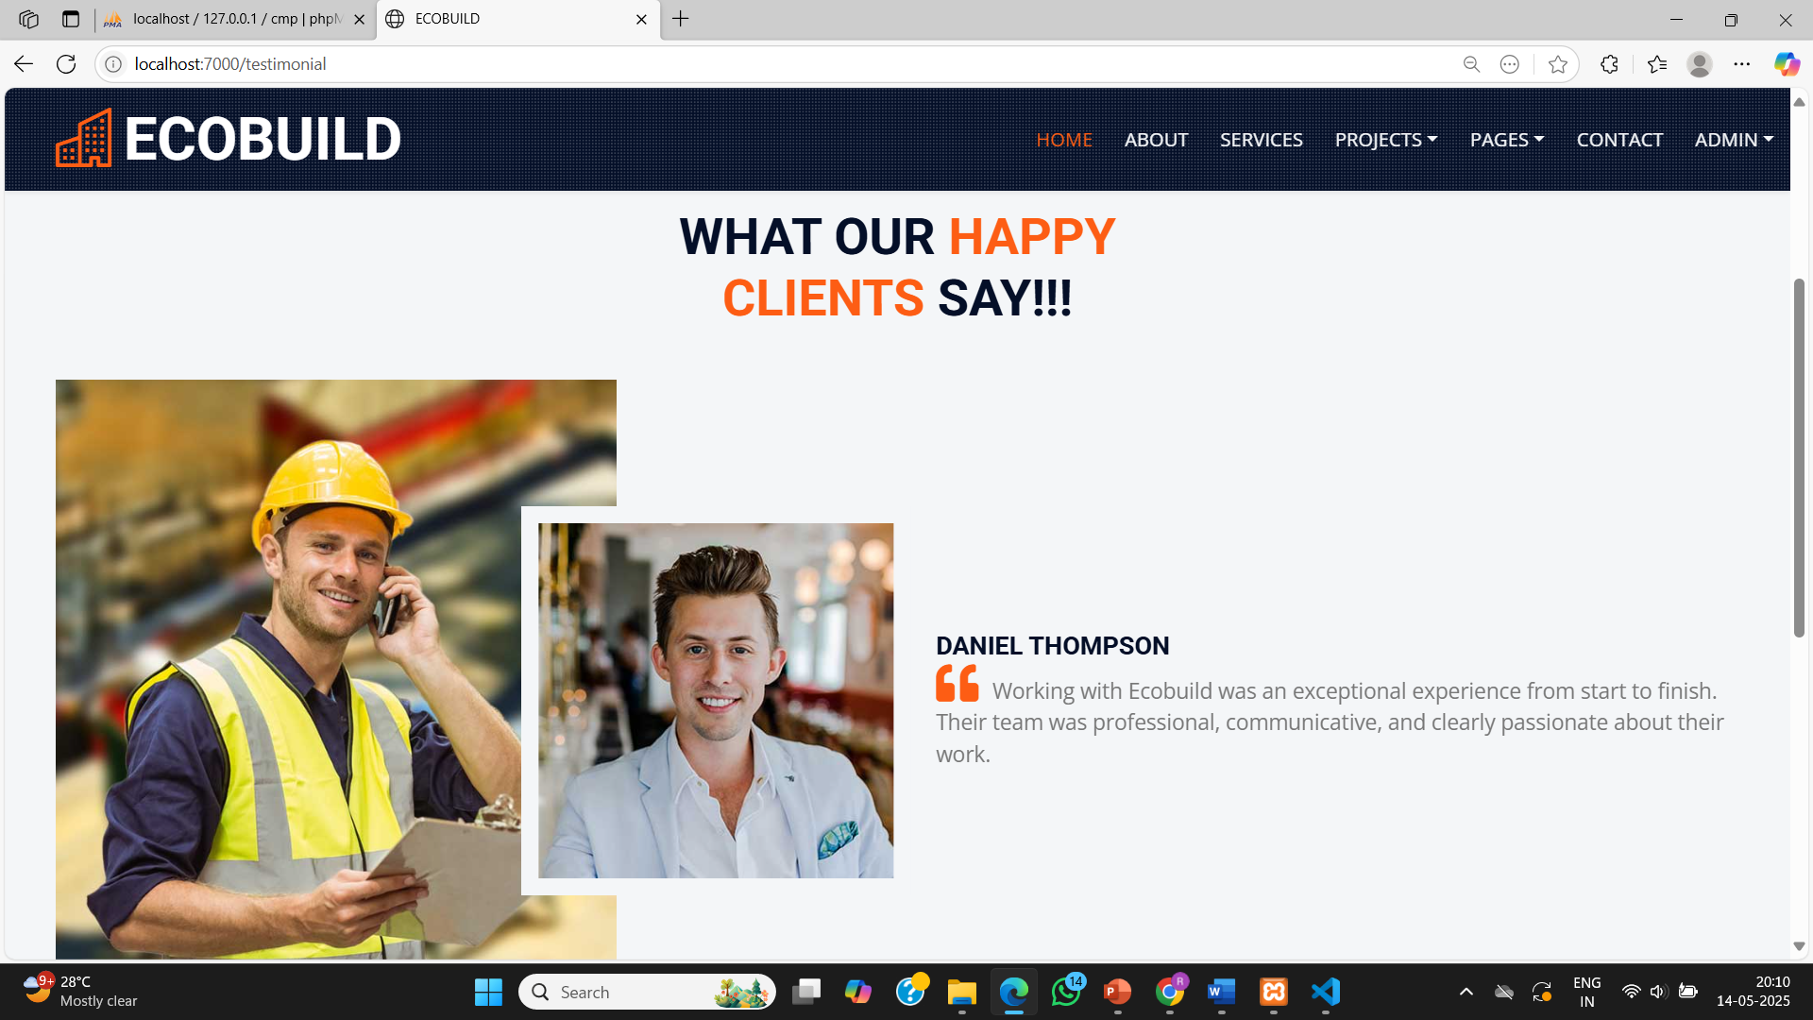
Fig 6:Testimonials

Slide 17
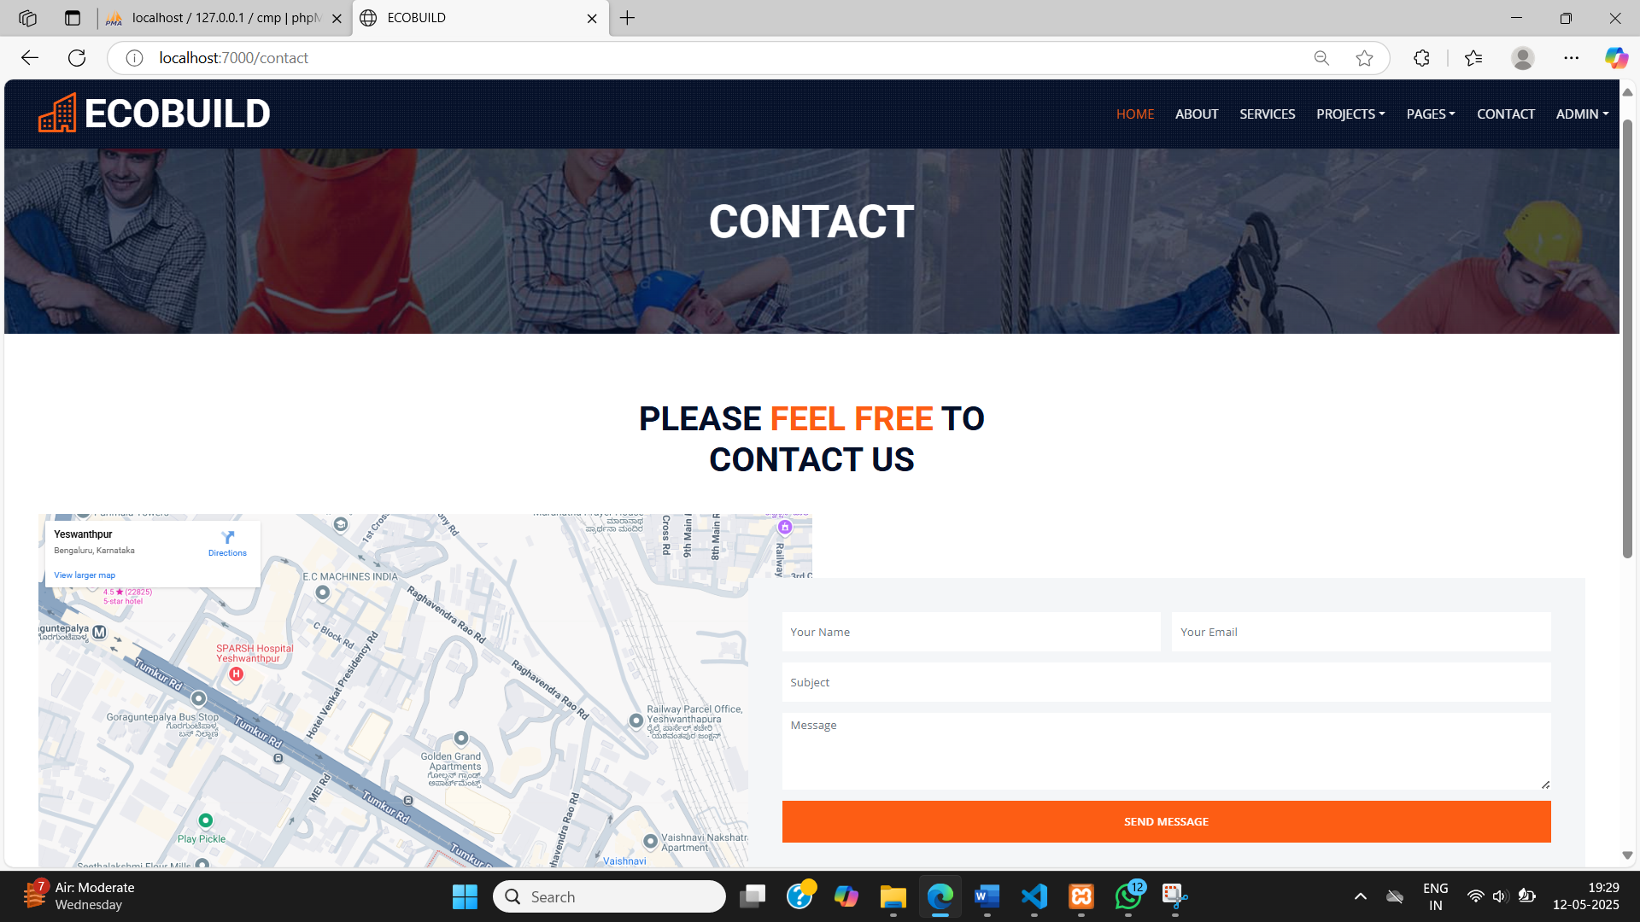
Fig 7:Contact Us Form

Slide 18
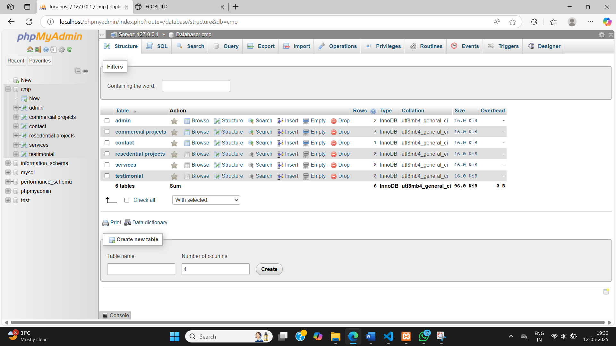
Fig 8:Database

Slide 19
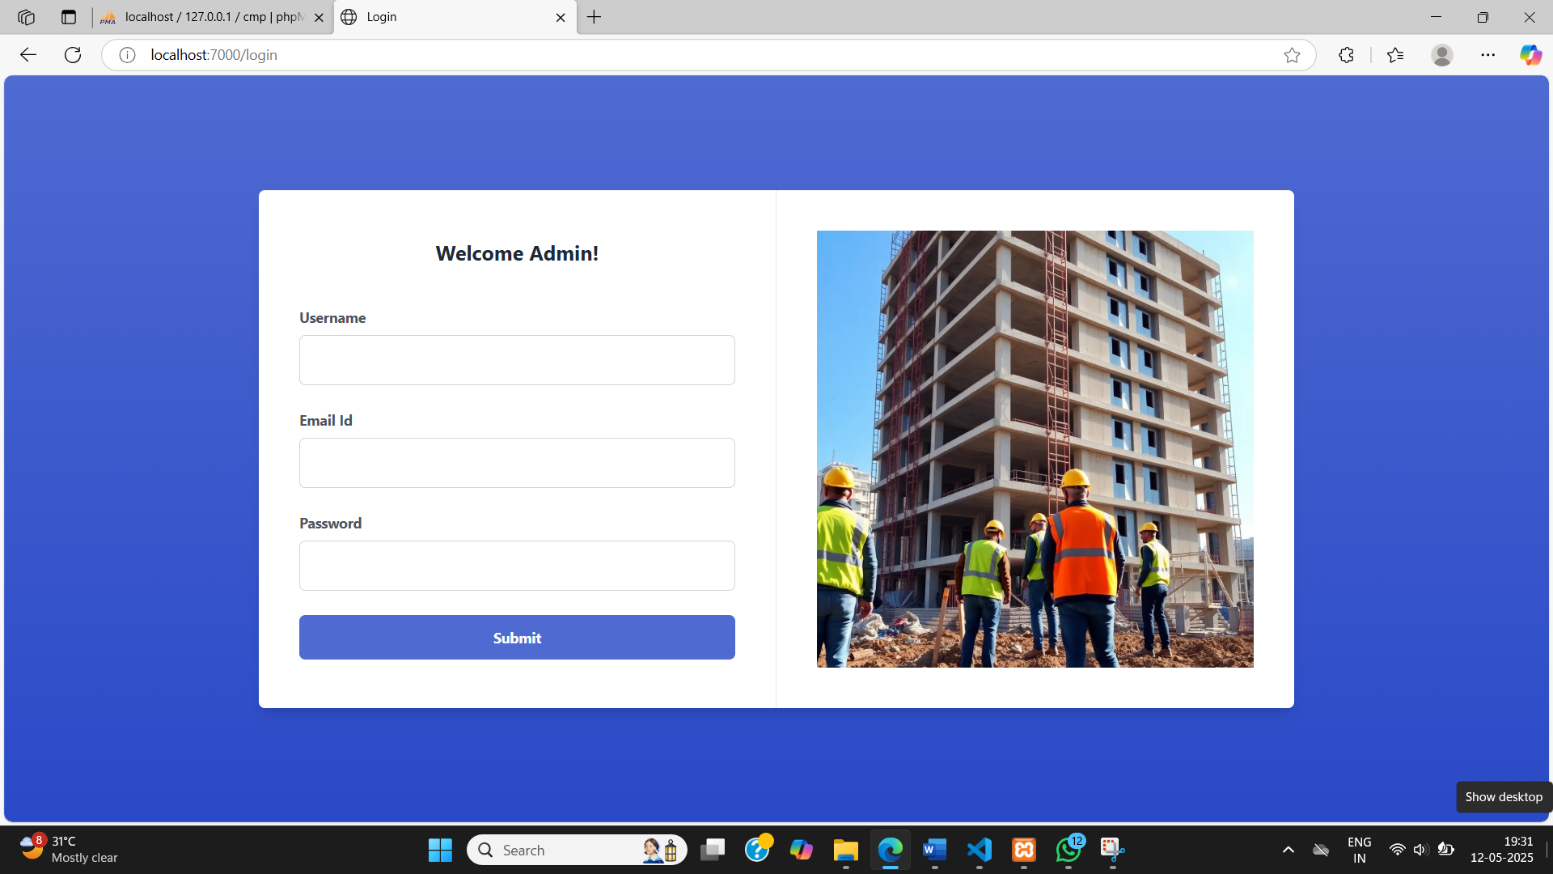
Fig 9:Admin Login

Slide 20
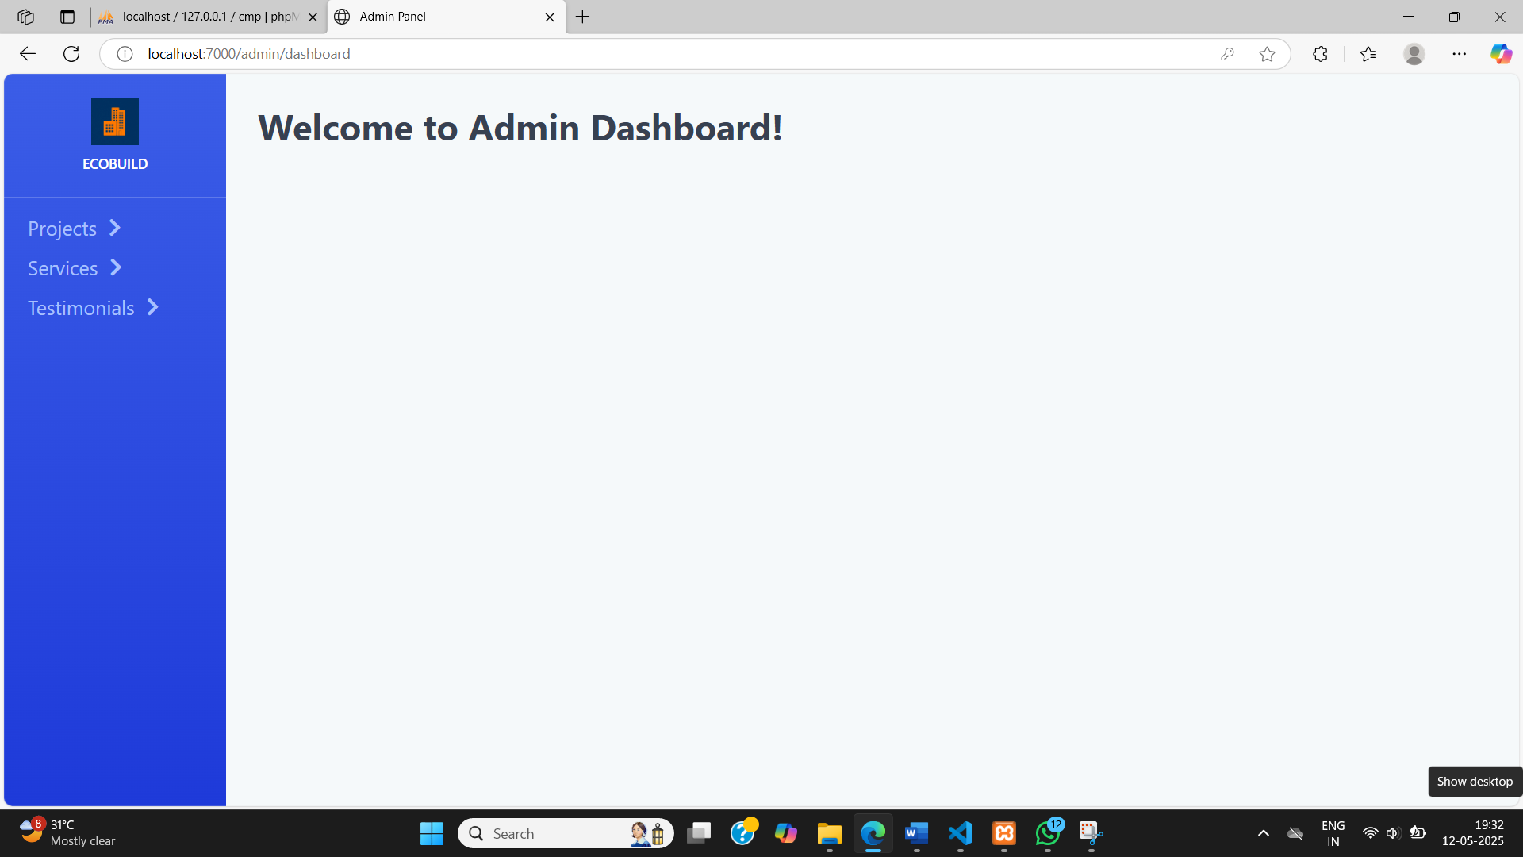
Fig 10:Admin Dashboard

Slide 21
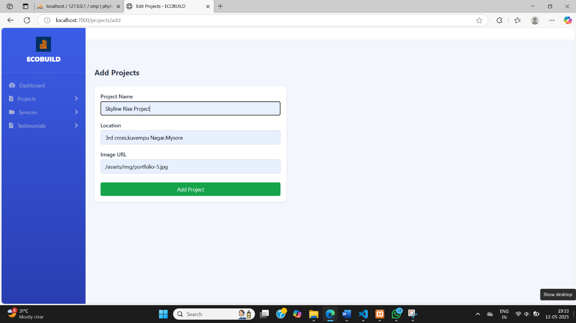
Fig 11:Add Projects

Slide 22
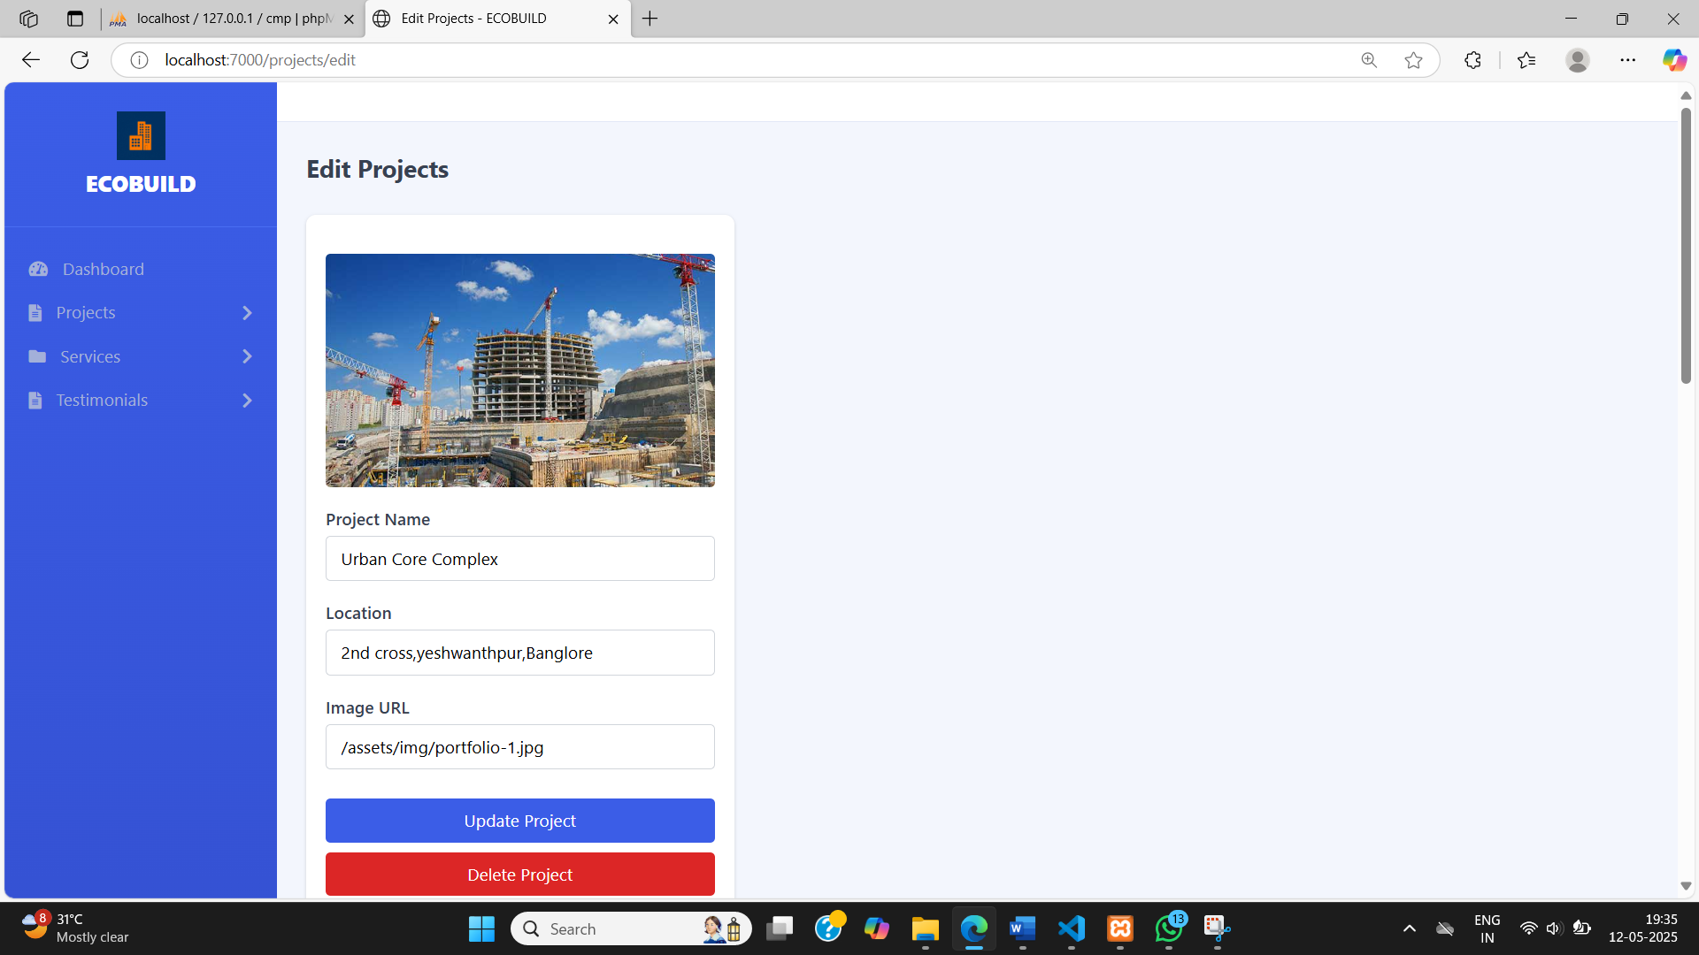
Fig 12:Edit Projects

Slide 23
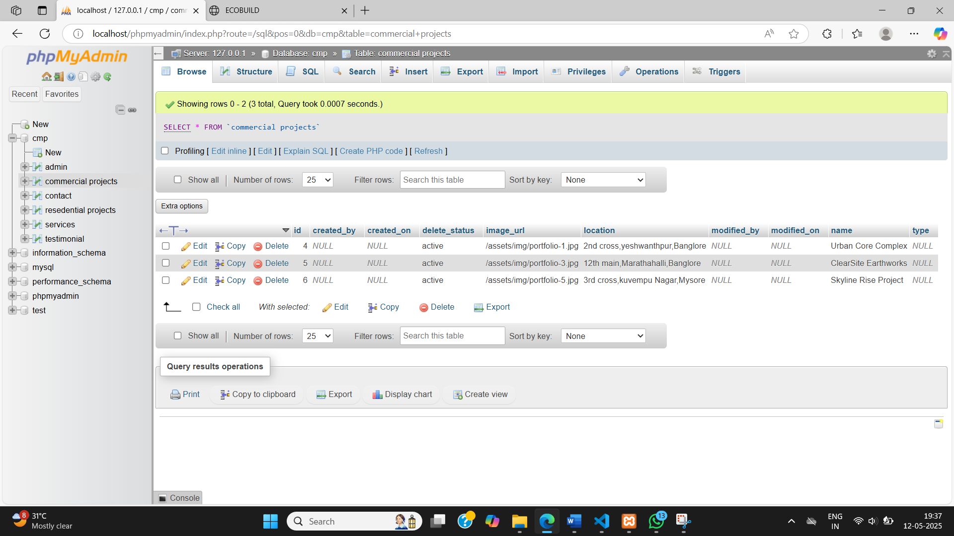
Fig 13:Data Stored in Mysql

Slide 24
FUTURE SCOPE
Add intelligent chatbots for answering FAQs, generating quotes, or guiding users through services.
Send updates to clients about new services, project updates, or appointment reminders through email notifications.
Extend the website functionality into Android/iOS apps using APIs developed in Spring Boot.

Slide 25
CONCLUSION
Dynamic website serves as a digital tool for the construction company to showcase its expertise, engage with clients, and promote trust through real testimonials.
Admins can manage content easily, increasing productivity and reducing reliance on developers.
The website stays up-to-date with the latest information, which is crucial for a fast-moving industry like construction.

Slide 26
THANK YOU

